Slide 1
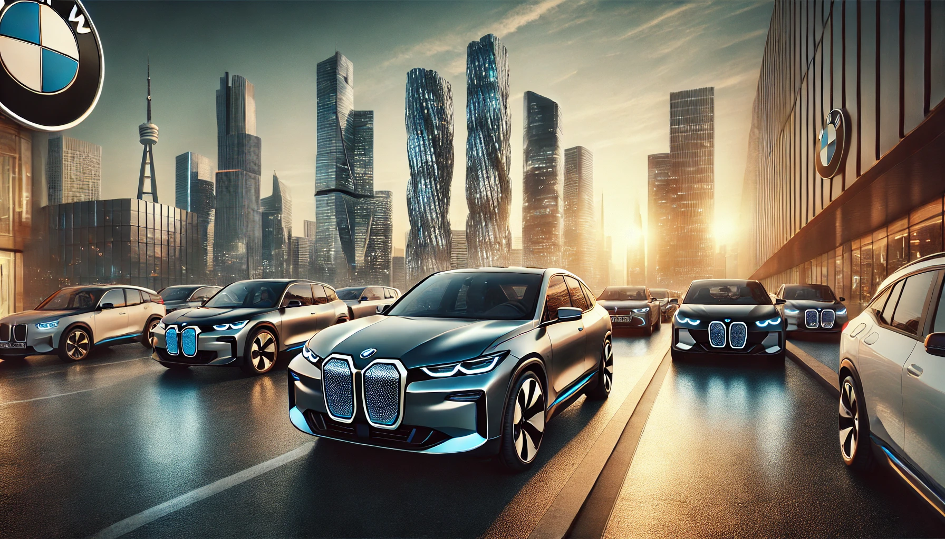
BMW Electric Vehicle Market Analysis

Slide 2

Business Problem Overview:
BMW is increasing its focus on electric vehicles (EVs) to compete with market leaders like Tesla, Audi, and Mercedes. However, despite launching a diverse lineup of EVs, BMW's market penetration in key regions is lagging behind. BMW needs a deeper understanding of its EV sales performance across regions, customer preferences for specific models, and a comparison with competitors' EV offerings. The company is seeking to uncover growth opportunities to increase its market share in the EV sector.
Project Objective:
The objective of this project is to analyze BMW’s electric vehicle (EV) sales data, customer preferences, and competitor performance in the EV market. The goal is to:
Evaluate BMW’s current EV sales performance by region and model.
Analyze customer preferences based on satisfaction, price, and EV features.
Benchmark BMW's market share and performance against competitors like Tesla, Audi, and Mercedes.
Identify untapped growth opportunities in the EV market.
Provide actionable recommendations to enhance BMW’s market penetration in the electric vehicle sector.

Slide 3
Database Structure Overview :
This slide provides an overview of the key tables in the BMW Electric Vehicle Market Analysis project. These tables store vital information such as BMW's EV models, competitor data, sales performance, and potential customer demographics. The table relationships help us analyze market trends, customer preferences, and growth opportunities.”
Tables in the Database:
Competitor_EVs: Stores information about competitors' electric vehicle models.
BMW_EVs: Holds details of BMW’s electric vehicles, including specifications like range and battery capacity.
BMW_Sales: Tracks sales data for BMW's electric vehicles across different regions.
Potential_Customers: Contains potential customer data, including interest levels and regional demographics.

Slide 4
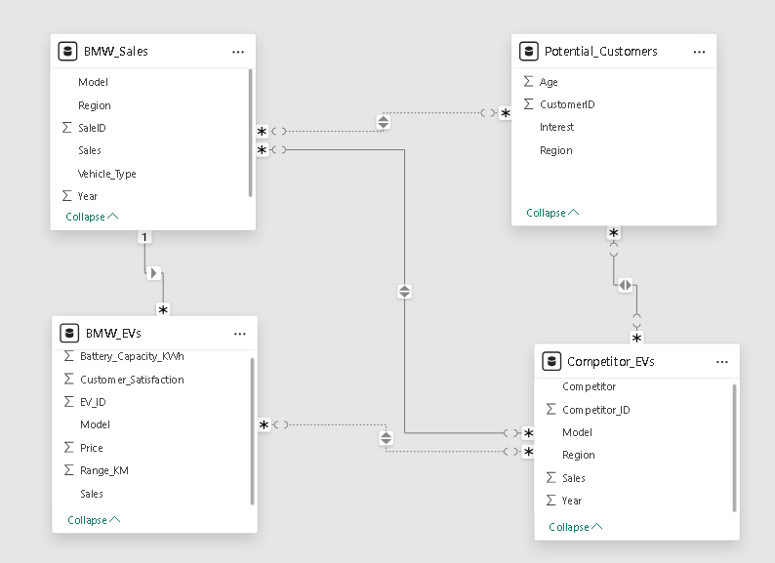
ERD Diagram

Slide 5
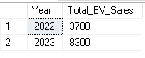
Sales Performance Analysis:
1. How have BMW's electric vehicle (EV) sales trended over time (year-by-year)?
SELECT Year, SUM(Sales) AS Total_EV_Sales
FROM BMW_Sales
WHERE Vehicle_Type = 'Electric'
GROUP BY Year
ORDER BY Year ASC;

Slide 6
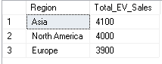
Sales Performance Analysis:
2. Which regions are contributing the most to BMW's electric vehicle (EV) sales?
Input:
SELECT Region, SUM(Sales) AS Total_EV_Sales
FROM BMW_Sales
WHERE Vehicle_Type = 'Electric'
GROUP BY Region
ORDER BY Total_EV_Sales DESC;
Output :

Slide 7
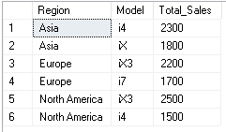
Sales Performance Analysis:
3. Which BMW electric vehicle (EV) models are performing the best across different regions?
Input:
SELECT Region, Model, SUM(Sales) AS Total_Sales
FROM BMW_Sales
WHERE Vehicle_Type = 'Electric'
GROUP BY Region, Model
ORDER BY Region, Total_Sales DESC;
Output :

Slide 8
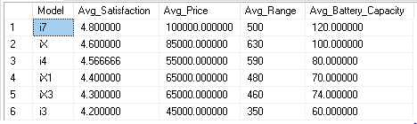
2. Customer Preferences Analysis:
1. How do customer satisfaction ratings vary for different BMW EV models, and which features (price, range, battery capacity) are most valued by customers?
Input:
SELECT Model, AVG(Customer_Satisfaction) AS Avg_Satisfaction,
AVG(Price) AS Avg_Price, AVG(Range_KM) AS Avg_Range, AVG(Battery_Capacity_KWh) AS Avg_Battery_Capacity
FROM BMW_EVs
GROUP BY Model
ORDER BY Avg_Satisfaction DESC;
Output :

Slide 9
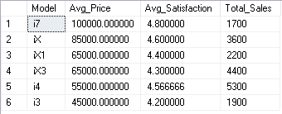
2. Customer Preferences Analysis:
2. How does pricing impact customer satisfaction and sales volume for BMW’s electric vehicle (EV) models?
Input:
SELECT Model, AVG(Price) AS Avg_Price, AVG(Customer_Satisfaction) AS Avg_Satisfaction, SUM(Sales) AS Total_Sales
FROM BMW_EVs
GROUP BY Model
ORDER BY Avg_Price DESC;
Output :

Slide 10
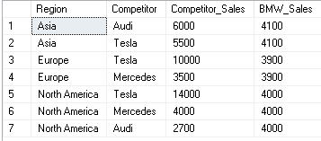
3. Competitor Benchmarking:
1. How do BMW's electric vehicle (EV) sales compare to those of its competitors (e.g., Tesla, Audi, and Mercedes) in various regions?
Input:
SELECT c.Region, c.Competitor,
SUM(c.Sales) AS Competitor_Sales,
(SELECT SUM(b.Sales)
FROM BMW_Sales b
WHERE b.Region = c.Region AND b.Vehicle_Type = 'Electric') AS BMW_Sales
FROM Competitor_EVs c
WHERE c.Competitor IN ('Tesla', 'Audi', 'Mercedes')
GROUP BY c.Region, c.Competitor
ORDER BY c.Region, Competitor_Sales DESC;
Output :

Slide 11
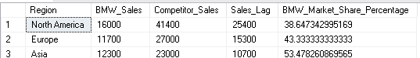
3. Competitor Benchmarking:
2 . In which regions is BMW underperforming compared to its competitors, and what factors may be contributing to its lag in market share?
Input:
SELECT
c.Region, SUM(b.Sales) AS BMW_Sales, SUM(c.Sales) Competitor_Sales,
(SUM(c.Sales) - SUM(b.Sales)) AS Sales_Lag, (SUM(b.Sales) * 100.0 / SUM(c.Sales)) AS BMW_Market_Share_Percentage
FROM Competitor_EVs c
LEFT JOIN BMW_Sales b ON c.Region = b.Region AND b.Vehicle_Type = 'Electric'
WHERE c.Competitor IN ('Tesla', 'Audi', 'Mercedes')
GROUP BY c.Region
HAVING SUM(b.Sales) < SUM(c.Sales) -- BMW underperforming in these regions
ORDER BY Sales_Lag DESC;
Output :

Slide 12
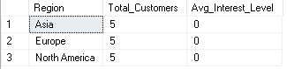
4. Growth Opportunities Analysis:
1. Which regions show the highest levels of customer interest in electric vehicles, and how can BMW tailor its marketing efforts to these regions?
Input:
SELECT Region,COUNT(CustomerID) AS Total_Customers,AVG(CASE
WHEN Interest = 'High' THEN 5
WHEN Interest = 'Medium' THEN 3
WHEN Interest = 'Low' THEN 1 ELSE 0
END) AS Avg_Interest_Level
FROM Potential_Customers
WHERE Interest IS NOT NULL -- Ensure only valid interest data is considered
GROUP BY Region
ORDER BY Avg_Interest_Level DESC;
Output :

Slide 13
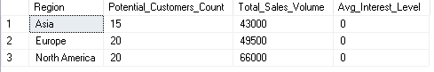
4. Growth Opportunities Analysis:
2. How does the interest level of potential customers in different regions correlate with actual sales performance for BMW's EVs?
Input:
SELECT pc.Region,COUNT(pc.CustomerID) AS Potential_Customers_Count,
SUM(bs.Sales) AS Total_Sales_Volume,AVG(CASE
WHEN pc.Interest = 'High' THEN 5
WHEN pc.Interest = 'Medium' THEN 3
WHEN pc.Interest = 'Low' THEN 1 ELSE 0
END) AS Avg_Interest_Level
FROM Potential_Customers pc
JOIN BMW_Sales bs
ON pc.Region = bs.Region
GROUP BY pc.Region
ORDER BY Avg_Interest_Level DESC;
Output :

Slide 14
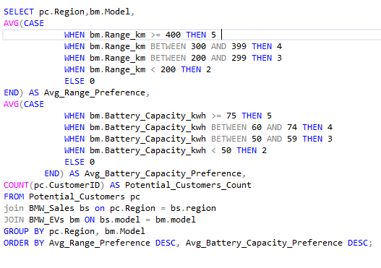
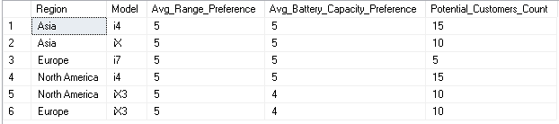
4. Growth Opportunities Analysis:
3. Which EV features (e.g., range, battery capacity) are most important to potential customers in different regions, and how can BMW align its EV offerings to meet these preferences?
Input:
Output :

Slide 15
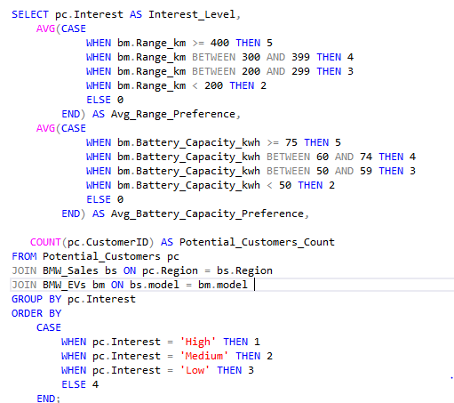
4. Growth Opportunities Analysis:
4. How do interest levels of potential customers correlate with the features they value most and how can BMW prioritize these features in its product lineup?
Input:
Output :

Slide 16
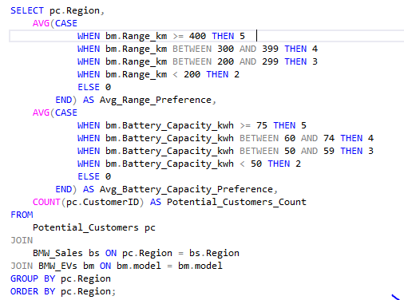
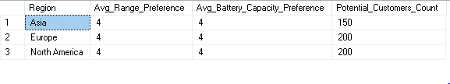
4. Growth Opportunities Analysis:
5. How do feature preferences (e.g., range, battery capacity) vary by region, and how can BMW adapt its EV product offerings to different regional markets?
Input:
Output :

Slide 17
Recommendations for BMW's Electric Vehicle (EV) Strategy
Based on the findings from the analysis of BMW's EV sales performance, customer preferences, competitor benchmarking, and growth opportunities, we can outline several key recommendations for BMW to enhance its market position and align its product offerings with customer needs.
Sales Performance Analysis
Recommendation: Expand Focus on High-Growth Regions
Regions with Strong Sales: Focus marketing and product development efforts on regions contributing the most to BMW's EV sales (e.g., Europe and North America), where demand is already high. Tailor campaigns to regional preferences and increase dealership presence to strengthen BMW's market position.
Model-Specific Strategies: Given the strong performance of certain BMW EV models (e.g., i4, iX), consider increasing production and availability of these high-performing models. In regions where specific models underperform, conduct in-depth market research to identify barriers to adoption and adjust strategies accordingly.
2. Customer Preferences Analysis
Recommendation: Align EV Offerings with Customer Preferences
Feature Preferences: Customers value features like longer range and higher battery capacity in their electric vehicles. BMW should prioritize these features in new models, ensuring competitive advantages in key regions.
Model Satisfaction: Focus on improving customer satisfaction with existing models by addressing areas like pricing and battery performance. Conduct regular surveys to track satisfaction and use insights to fine-tune future releases.
Pricing Strategy: Pricing appears to have a significant impact on sales volume and customer satisfaction. BMW should adopt a flexible pricing strategy that considers regional income levels, competitor pricing, and consumer purchasing power, especially in emerging EV markets.

Slide 18
Recommendations for BMW's Electric Vehicle (EV) Strategy
3. Competitor Benchmarking
Recommendation: Close the Gap with Competitors
Competitive Analysis: Benchmark against key EV competitors such as Tesla, Audi, and Mercedes. In regions where BMW's market share lags behind competitors, identify reasons for underperformance. This could involve analyzing price sensitivity, brand perception, or local infrastructure (e.g., charging networks).
Regional Market Share: In regions where BMW underperforms, launch targeted marketing campaigns, partnerships, or promotional discounts to improve awareness and adoption. Leverage brand loyalty and create incentives to encourage customers to make the switch from competitors' vehicles to BMW EVs.
4. Growth Opportunities Analysis
Recommendation: Target High-Interest Customer Segments
Targeted Marketing: Based on the regions showing the highest levels of customer interest, BMW should focus its marketing strategies on these areas. Engage with high-interest customer segments through personalized campaigns, educational content about EV benefits, and test-drive programs.
Align Products with Customer Needs: In regions where, potential customers show strong preferences for specific features (e.g., longer range or greater battery capacity), BMW should adapt its product offerings to better align with these demands. This could include introducing upgraded versions of existing models with enhanced features or launching new models designed specifically to meet these regional preferences.
Feature Prioritization: BMW can prioritize range and battery capacity based on customer preferences and age groups. Focus on improving these key features in future EV models to cater to evolving customer needs, especially in regions with high interest in advanced EV technologies.

Slide 19
Recommendations for BMW's Electric Vehicle (EV) Strategy
5. Product Development and Adaptation
Recommendation: Customize Product Offerings Based on Regional Demand
Feature Customization by Region: BMW should ensure that different regional markets get tailored EV offerings that match local expectations. For example, regions with longer commutes may prioritize EVs with higher range, while urban areas may value compact models with quick charging capabilities.
Research & Development: Invest in R&D for advanced battery technology to enhance range and charging speed, which are increasingly important to customers. This will help BMW stay ahead of competitors and remain the preferred choice for technology-driven customers.
6. Leveraging Potential Customer Segments
Recommendation: Enhance Product Alignment with High-Interest Segments
Customer Segment Targeting: BMW should refine its marketing efforts to specifically address high-interest customer segments in each region, using insights about age, interest levels, and regional preferences. Tailored communications around range, battery life, and eco-friendly technology could attract more customers from these segments.
Offer Incentives: Consider launching regional incentive programs (e.g., government subsidies, trade-in offers) to attract customers who are highly interested in EVs but are hesitant due to initial cost concerns.

Slide 20
Conclusion
By focusing on customer preferences, regional demand, and competitor strategies, BMW can continue to strengthen its position in the growing EV market. Implementing these recommendations will not only help BMW enhance its market share and customer satisfaction but also ensure that it remains competitive in the ever-evolving electric vehicle landscape.

